Slide 1
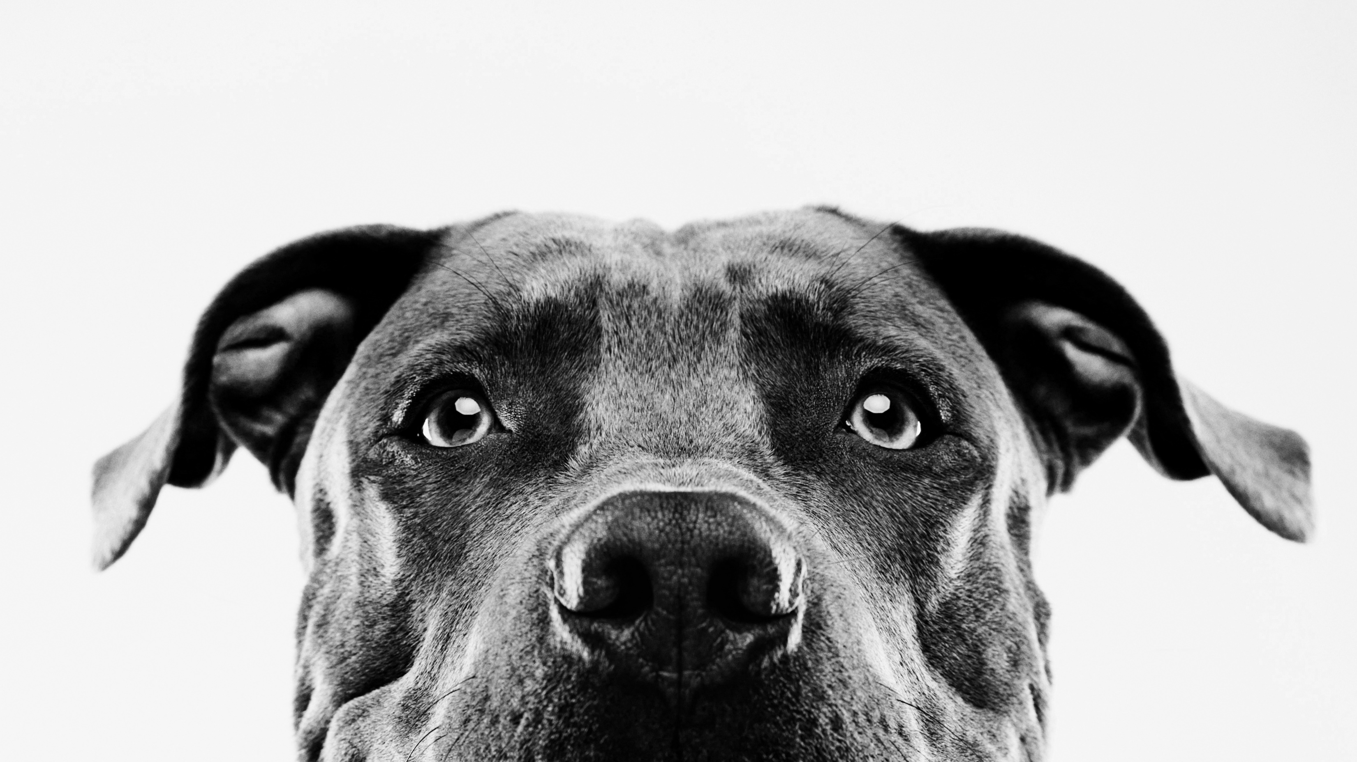
Navon Task
Additional Practice

Slide 2
Content
Brief introduction
Experimental Design
Test yourself! Guidelines provided

Slide 3

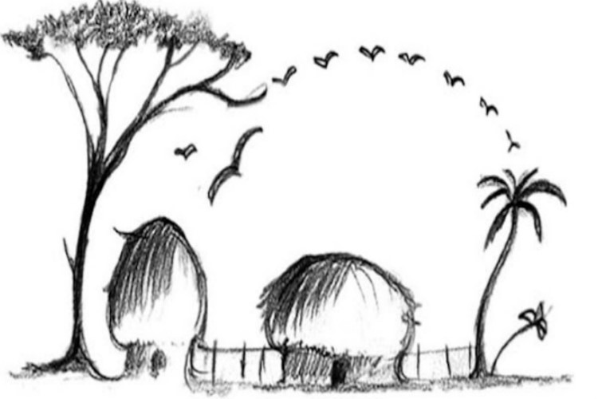
INTRODUCTION
Images contain both global (the whole) and local (the parts) features.
Navon’s task (Navon, 1977) was designed to explore the relationship between global and local perception.
It was hypothesized that perceptual processes are temporally organised so that they proceed from global structuring toward more and more fine-grained analysis, which was known as the Global Precedence Effect.
Global > Local

Slide 4
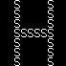
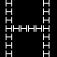
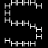
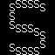
Experimental design
To investigate the global precedence effect, we could design an experiment using psychopy. Participants would be asked to respond to the smaller letters in congruent (i.e. Big S and small S) and incongruent (i.e. Big S and small H) trials. Participants should respond to the congruent trials faster than the incongruent trials .
Note that:
Independent variable: Congruence of small and large letters
Dependent variable: Reaction time in milliseconds

Slide 5
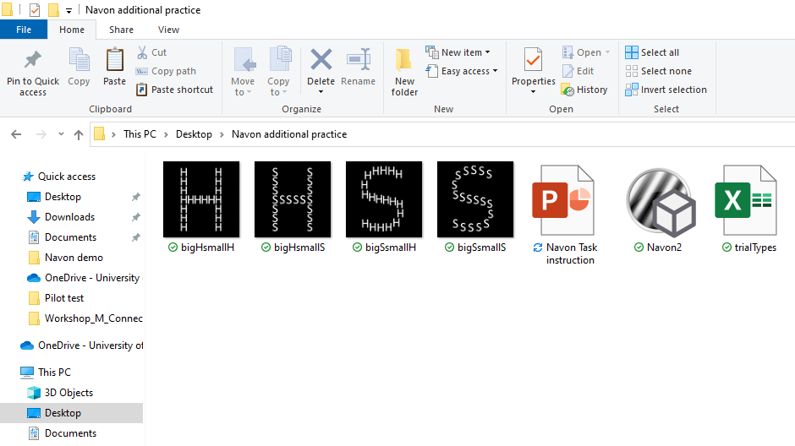
Test yourself (Guidelines)
Before you start designing the experiment,
Please make sure that the zipped folder “Navon additional practice” that you downloaded contain 4 images (BigHsmallH, bigHsmallS, bigSsmallH, bigSsmallS, mask), an excel file (trialTypes), a reference psychopy program (Navon2).
Make sure that the folder is UNZIPPED and placed in desktop.
Open psychopy and save it in the same folder “Navon stimuli”.

Slide 6
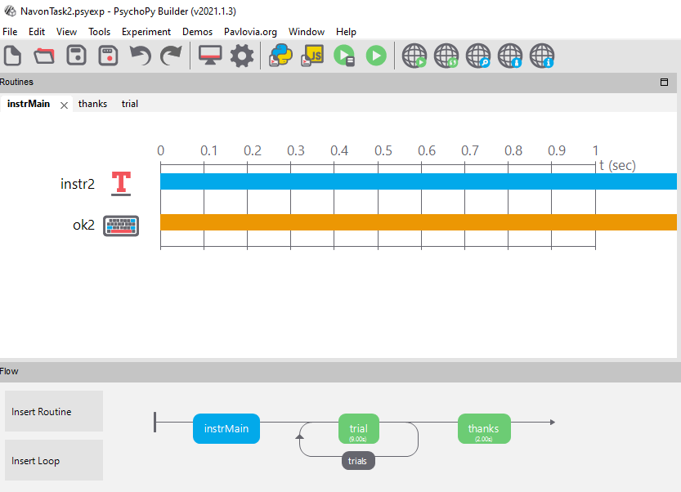
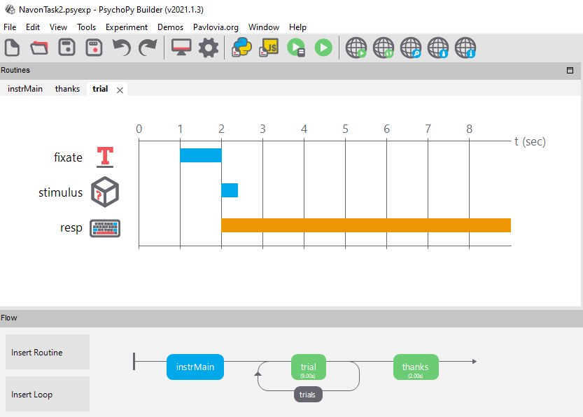
psychopy design
The general outline should look like this:
For instruction (instrMain) and thank you message (thanks) tabs, you need text and keyboard components.
For trial tab, you need text, image and keyboard components.

Slide 7
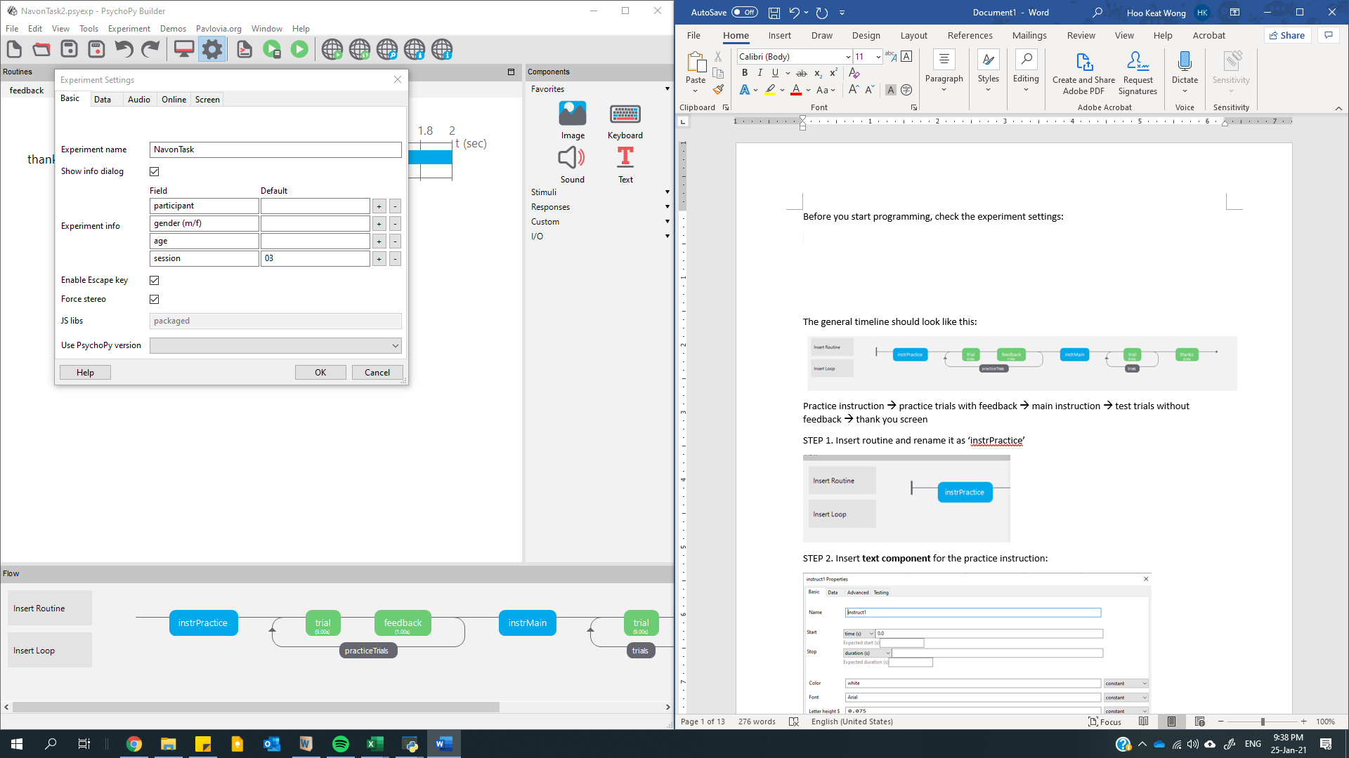
1st step: experiment setting
On the toolbar, select the Experiment Setting (the gearwheel icon).
What are the experiment information you need from the participants? (e.g. name, gender, age etc.)
Feel free to explore the experiment setting and change anything based on your preference (e.g. do you want to save the file in csv format?)

Slide 8
2nd step: instruction/thank you message
Start with inserting a new routine and rename it as “instrMain”.
You want participants to see the instruction/thank you message in text (text component) and allow any response for them to proceed once they finish reading (keyboard component).
Tip: You could copy paste the routine for “thanks”!

Slide 9
Text
You can copy paste the following message:
Instruction:
Welcome to the study!
Remember, press;
- 'S' if the SMALL letters are S
- 'H' if the SMALL letters are H
Try to respond as quickly and as accurately as possible.
When you are ready to proceed press any key.
Thank you message:
Thank you for your participation. Your responses have been recorded.
Press any key to exit the experiment.
You want the participants to read the message as long as they need. So, do we need to set a time limit for these two components?
Please adjust the letter height/font/color based on your computer setting. We recommend 0.05 for the letter height.

Slide 10
keyboard
Do you have a specific response key that you want participants to press in order to proceed to the next routine? If no, you could leave the “Allowed keys” empty.
Remember to tick “Force end of Routine” for the keyboard component so the experiment will go to the next routine once the participants press a key!

Slide 11
3rd step: Trial
Start with inserting a new routine and rename it as “trial”.
This time, you want participants to see a fixation cross (text component), the stimuli of congruent and incongruent letters (image component) and allow certain key of responses only (keyboard component).

Slide 12
Text
This is for the fixation cross. Put a “+” sign in the text box. Make it start at 1s and last for 1s.

Slide 13
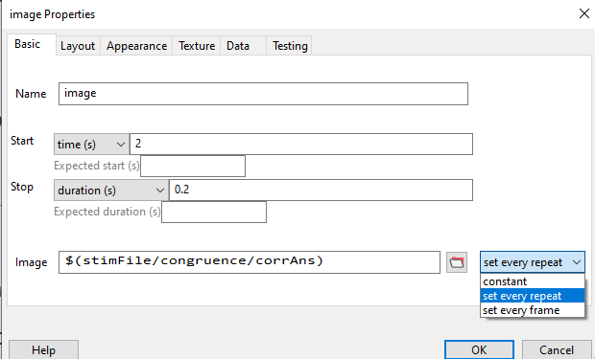
Image
In the “Image” row, let psychopy know what images to be displayed based on the excel sheet.
Open the excel sheet (trialTypes) in the “Navon additional practice folder” and have a think: which one (stimFile/congruence/corrAns) should be input in the “Image” row?
Put down your answer with a “$” in front and set every repeat. $ sign indicates that the stimuli keep changing.
Set the stimuli to start at 2s and last for 0.2s.

Slide 14
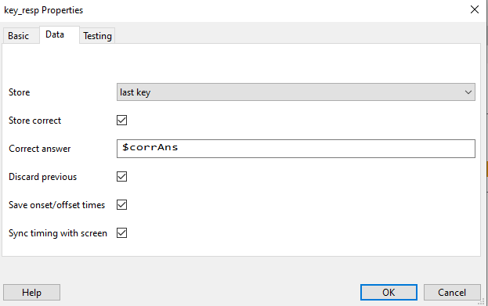
keyboard
We want the participants to respond AFTER the stimuli are shown. So, when do we start (refer to the previous slide, it’s time to do some simple calculation!) and how long do we want the response keys to be available?
The answers are provided at the bottom of this slide
What response keys do you allow this time for participants to respond to the small “s” and “h” letters?
Do you want to save the responses? If yes, please tick “Store correct” under Data tab, and let psychopy know what are the correct answers. We have provided the answers in the excel sheet so you just need to let psychopy know where to refer to it, i.e. $corrAns
Notes:
Start: 2.2s
Stop: you could set a limit (i.e. 7s) or leave it blank

Slide 15
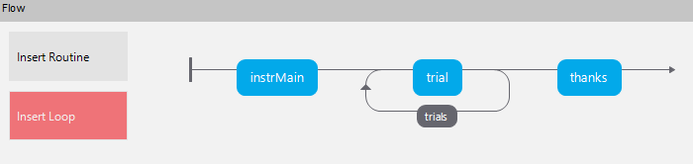
4th step: the loop
Insert a Loop that surrounds the ‘trial’ routine and rename it as ‘trials’.
Then, double click on the ‘trials’ and input the excel file (trialTypes) into the “conditions” row.
The stimuli could be set to show up randomly: loop type (random)
How many times do you want the experiment to repeat? For now, let’s just stick with one: nReps (1)

Slide 16
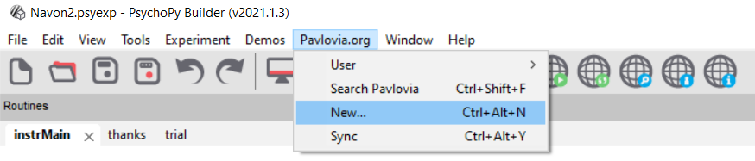
Last step: ready to be published!
Try running the experiment once and see if there is any error.
If the experiment could not be run, try troubleshooting it based on the error message that you get.
For reference, you could refer to the template (Navon 2) provided in the “Navon additional practice” folder.
Once you are ready, try publishing it online on Pavlovia. Click “Pavlovia.org” and press “New…”. Then, click “Create project on Pavlovia”. Make sure you have logged in your Pavlovia account!
You should be able to see your experiment on Pavlovia dashboard if you have successfully synced it online.

Slide 17
Well done!
You have completed the task, now it’s time to design your own experiment =)

